Slide 1
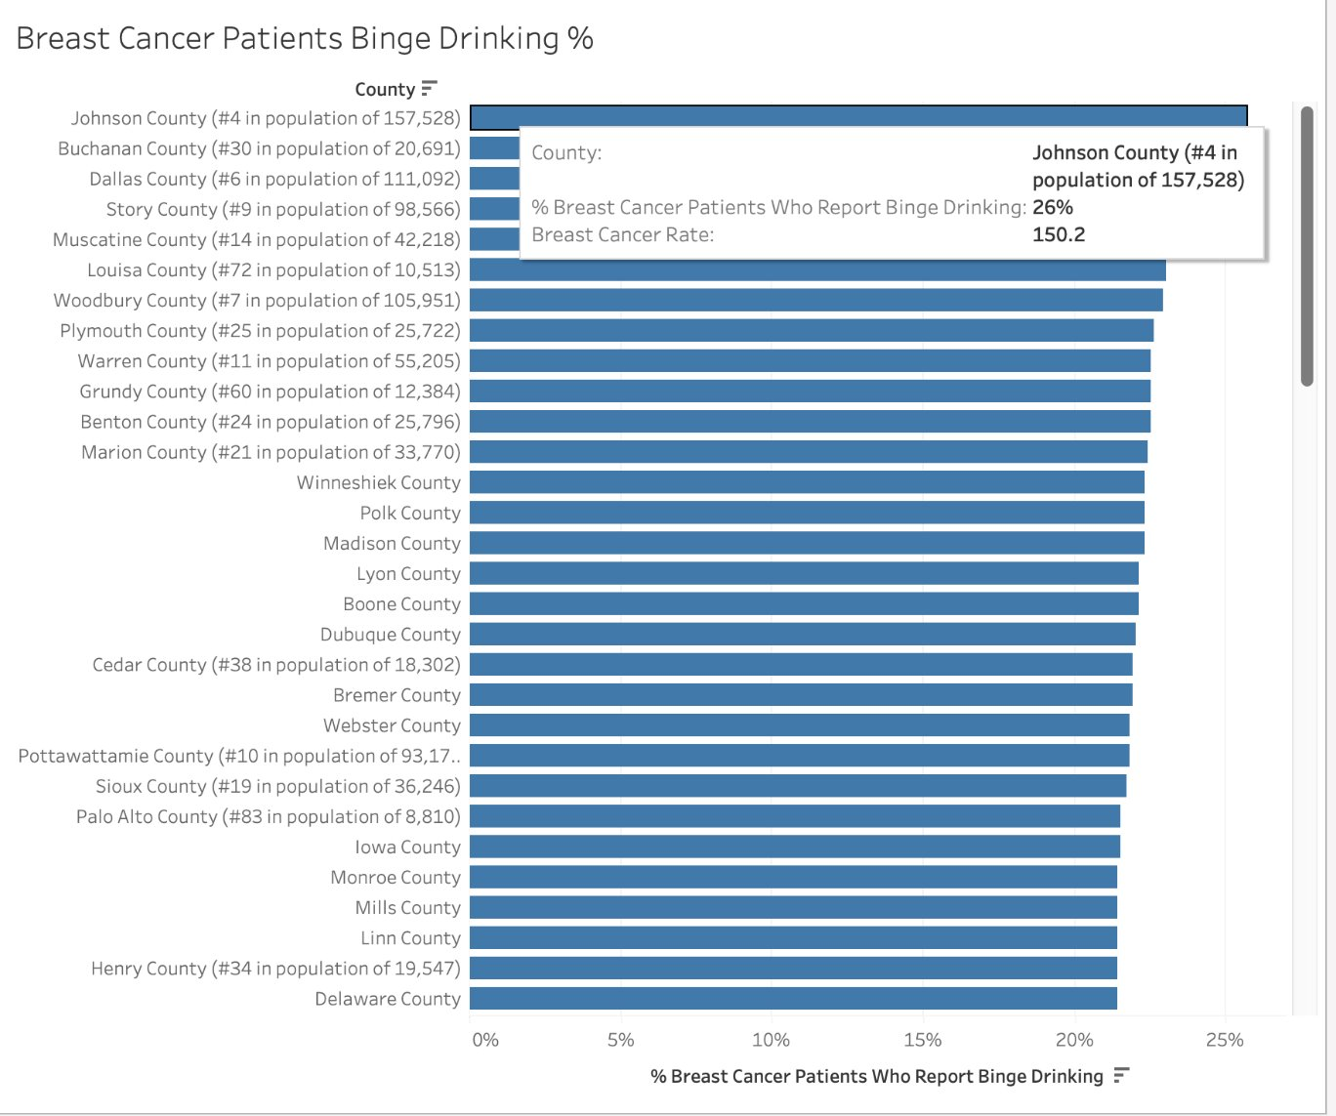
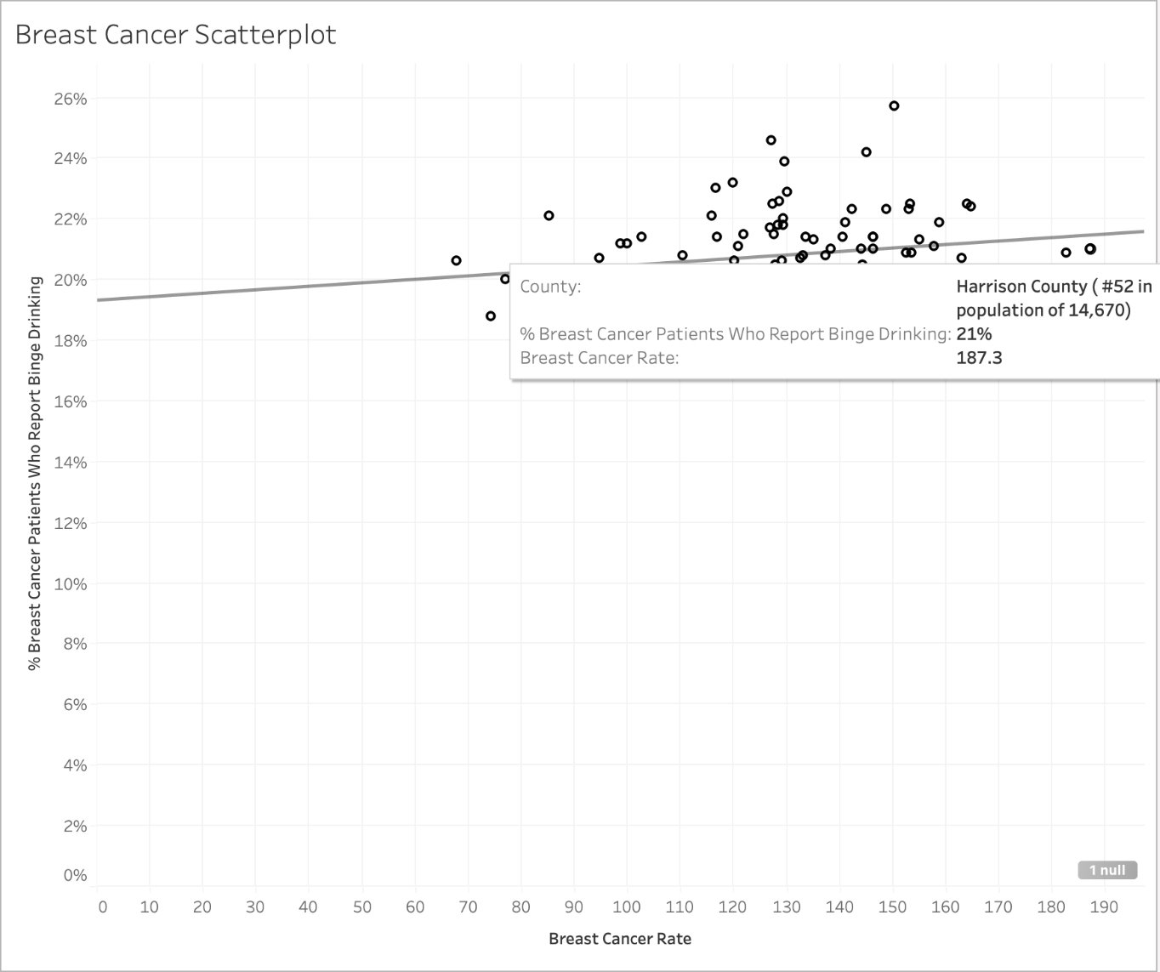
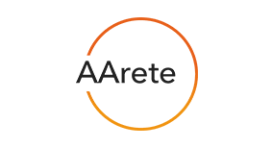
1. Objective
Iowa Cancer Rate Analysis
AArete 03 - 1
4. Data Description
6. Business Recommendation
Our objective was to identify key factors contributing to increasing cancer rates in Iowa relative to other US states. Our team considered four types of cancer: melanoma of the skin, breast cancer, lung cancer and prostate cancer. We also sought explanations as to why such factors are prevalent in Iowa.
The master dataset includes incidence rates and trends for each of the four researched cancer types, demographic factors, risk factor and risky behaviors incidence data, and population data.
Offering a 10% insurance premium discount to 1,000 high-risk individuals can generate substantial savings:
Single Coverage: Saves ~$844,000 annually
Family Coverage: Saves ~$2.397 million annually
These savings can fund targeted health initiatives while reducing overall insurer risk.
Targeted Health Engagement Strategy Launch a local TV campaign in high-risk regions (identified via Iowa Risk Score heat map):
30-second spots at a cost of $1,500–$3,500
Focus on prevention, screening, and enrollment
Track Campaign Effectiveness
Measure total TV viewership
Monitor website traffic and sign-ups
This approach combines direct cost reduction with long-term health improvement, maximizing ROI for both insurers and the population.
5. Risk Factor Visuals
2. Assumptions and Challenges
Assumptions: Iowa cancer rates may be higher than U.S. average due to a combination of lower-screening rates and greater exposure to common risk factors such as higher smoking prevalence, agricultural pesticide exposure, and behavioral factors.
Challenges: Availability of data consistent over time periods. Large scope of data analysis (risk factor and behavior choices). Distinguishing between factors respondent to a cancer diagnosis vs. potentially contributing to a diagnosis
3. Methodology
We created a master data set to analyze a wide range of risk factors. From the data we made regression models to find correlation between risk factors and cancer rates. We further analyzed the positive relationships and created more visuals using the data.
Notes:
Hyebin - I have tried to make handouts.

